Slide 1
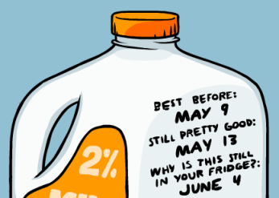
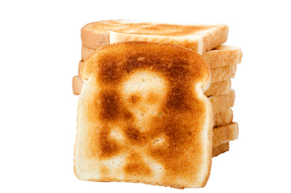
Nutritional Value Of Expired Foods
Presented by: Laura Lynn Iacono MS, RDN Nutrition Resource Manager Long Island Cares- Harry Chapin Food Bank

Slide 2
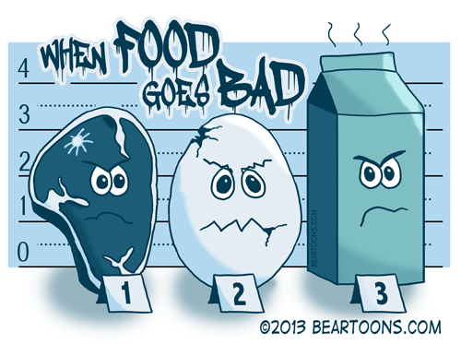
Do all foods have the same rate of expiration?
You don’t have to throw out perfectly good food
Let’s look at the shelf life food categories

Slide 3
How long does food really last ?
From the fresh source, best ingredients to the ordinary, I will provide you with a diverse and informative perspective on food shelf life, expiration, best by, better by, use by dates, nutritional value, food storage and more. Today I will focus on helping your food pantry, soup kitchen and or shelter eat healthy, and how to educate your clients on food & nutrient shelf life and debunk the myth of expiration dates on food.
It may come as a shock, but printed food dates are not federally regulated and do not refer to food safety. Thus, it is usually safe to eat your “expired” food after its printed date has passed.

Slide 4
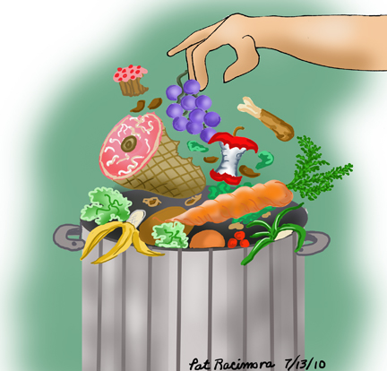
To Toss or Not to Toss?
The expiration dates on foods reflect when to buy or use a product at its best nutritional quality. So, while you won’t necessarily get sick from eating expired food, its freshness and nutrient value may be diminished depending on different factors. Therefore, the trick is to know how long a product is safe to eat after its “expiration” date.

Slide 5
What is Nutritional Value?
The nutritional value of food is what a food is made of and its' impact on the body.
Because of disease and weight control, it's particularly important to understand the nutritional value of food due to the impact on the body as it relates to cholesterol, fat, salt, and sugar intake.
The food label is the primary tool enabling consumers to understand nutritional values in order to make informed decisions about consumption.

Slide 6
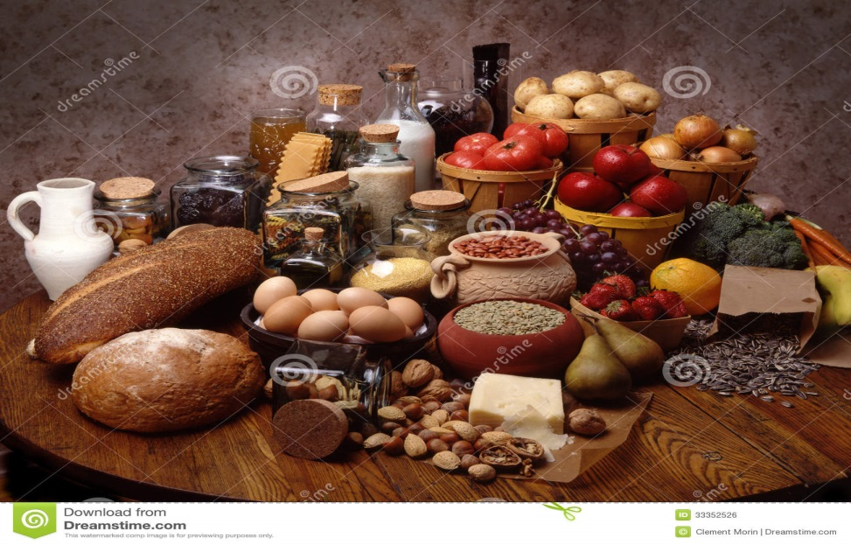
Nutritional Value of Foods
Some foods have more nutritional value than others and are assigned a number, valued and ranked
Foods are ranked “nutritious” based on there genetic make-up of macro and micro nutrients. That being naturally-containing Vitamins, Minerals, Carbohydrates, Proteins, Fats.

Slide 7
Nutritional Value Content Rankings

Slide 8
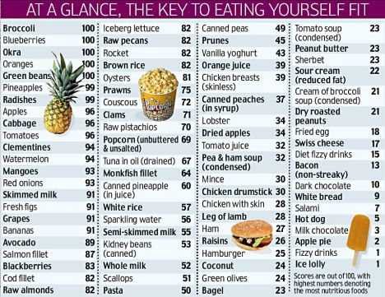
Notes:
Let’s take a look at the numbers next to the food. This represents their nutritional value. The higher the number the bigger or the more nutritional value for your body in it’s natural state before cooking

Slide 9
Different ways Foods lose their nutritional value?
Cooking Methods (Boiling, Baking Frying, Blanching, Steaming, Grilling, etc.)
Improper Storage ( Hot, Cold, Wet, Dry)
Improper Temperatures ( Hot, room temp and cold)
Light and Dark Sensitivity (counter, cabinet, basement)
Damaged food products, dented cans, air pinholes.

Slide 10
Stability of Various Nutrients in Storage
Stability & Sensitivity of Nutrient
Nutrient
Vitamin A & B-Carotenes
Vitamin C
Vitamin D
Folic Acid & Vit K
Vitamin B-6
Carbohydrate & Protein
Fat
Air, light & heat
Same
Light and Heat
Air, light & heat
Air, light & heat
Relatively stable
Can become rancid at higher temperatures

Slide 11
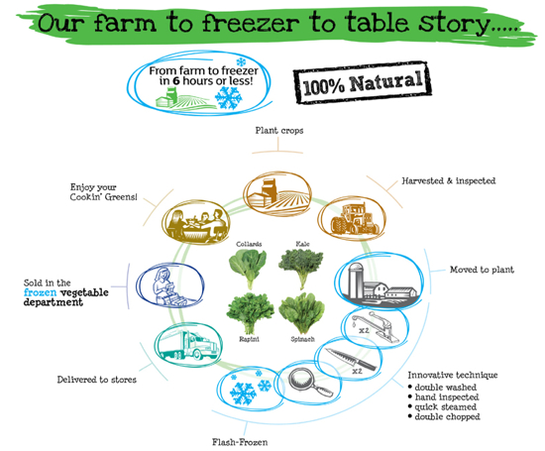
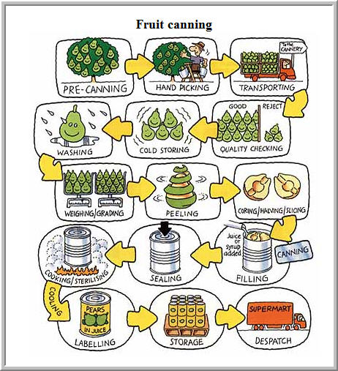
Farm to Can or Freezer is best
Notes:
Harvesting, moving to freezer plant. Some nutrients are lost in blanching not all freezer plants blanch more steam for IQF then cold air blast.
All these processes occur before the food even gets a day past it’s so called best by or after its expiration date. So what processes and or events will further make a food product after this process further cause a food to have it’s nutritional value compromised?

Slide 12
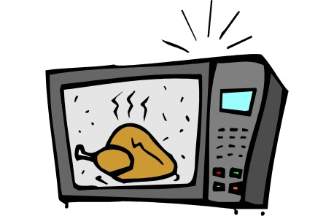
How does microwaving affect the nutritional value of food?
Pros
Cons
Cooks quickly
Small heat time exposure
Minimal to zero liquid needed
Retains vitamins & minerals in all foods
Kills bacteria
Steam vs. boil
Over cooking ruins food texture and taste if not properly used
Scalding and burns
Most food items should be covered
None regarding nutritional value and retention of nutrients
Notes:
Best method of cooking is microwave= quick, exposes food to heat for the smallest amount of time and uses a minimal amount of liquid.
Boiling spinach can remove up to 70% of folate/folic acid. Microwaving can retain 80-100% of folic acid leaving it bioavailable for you body to use for nourishment.
Cooking bacon on a griddle until crispy can create cancer causing nitrosamines.

Slide 13
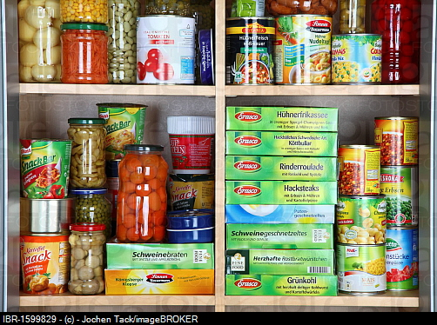
The pantry or cupboard
Pantry, or shelf stable (nonperishable) foods, like cereal, baking mixes, and peanut butter may display “best if used by (or before)” dates. These indicate the shelf-life of a product—they tell you when a product is no longer at peak flavor, texture, and appearance. You can safely eat most of these types of foods past their listed date if they’ve been stored properly, but they may not taste their best or be as nutritious. There are two major categories of pantry foods, unprocessed and processed:

Slide 14
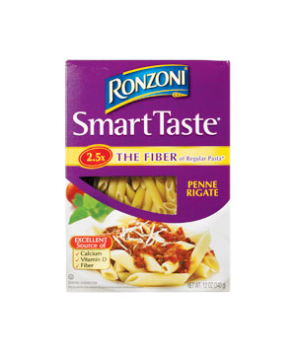
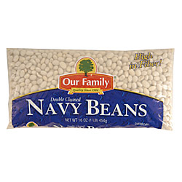
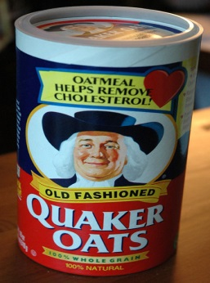
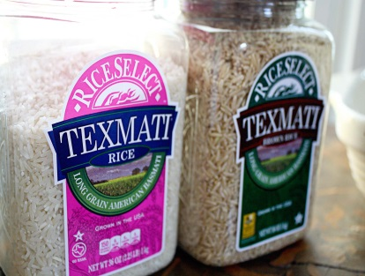
Dry unprocessed pantry foods
Unprocessed pantry foods: These include pastas, cereal, baking mixes, dry beans, grains, and nuts. If they have been stored unopened, these shelf stable foods should be good to eat indefinitely unless the packaging has been damaged. After opening, store these products in airtight containers to keep out insects, humidity, other odors, and to keep in flavor.

Slide 15
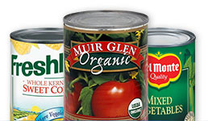
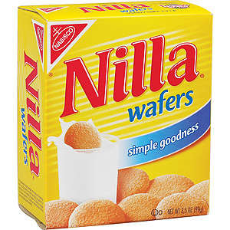
Processed Pantry foods
Processed pantry foods: These are considered shelf stable because they have either been heat treated (canned foods), are a dry formulation (cake mixes), or have reduced water content (dried foods, crackers). The quality of these products should also be fine until opened. But watch out for cans that develop cracks at the seams, bulge, or spurt liquid when opened. These changes may indicate the presence of a bacterium called Clostridium botulinum, the toxin that causes botulism. If this happens, the cans should be discarded. Note also that certain processed pantry foods must be refrigerated once you’ve opened them. To keep these foods at their best quality, store them in clean, dry, cool (below 85°F) cabinets away from the stove or the refrigerator's exhaust. (60-79 F) is best

Slide 16
Extended Shelf life of New Twinkies 19 days longer…….

Slide 17
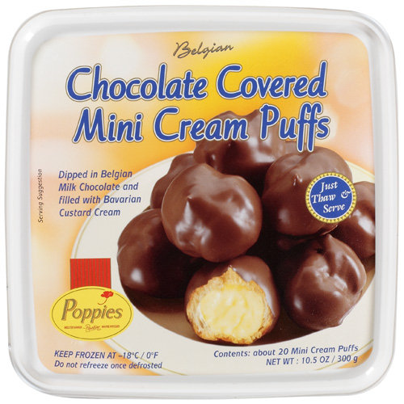
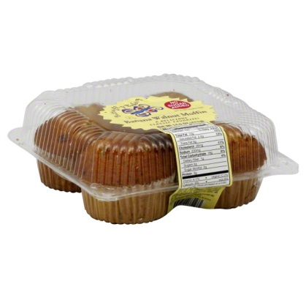
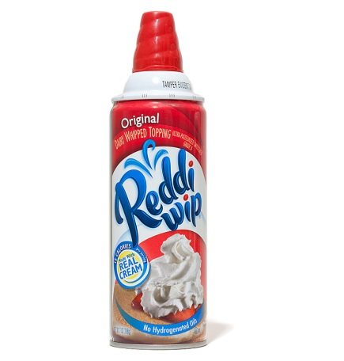
The Counter Top
The Countertop
Bakery items (which should have a “sell-by” date) that contain custards, meat, vegetables, or frostings made of cream cheese, whipped cream, or eggs should be kept refrigerated. Any bread product not containing these ingredients, or those that contain eggs but have been baked (like muffins), can safely be kept at room temperature. These foods should be good for about a week. However, if you begin to see signs of mold, they should be tossed.

Slide 18
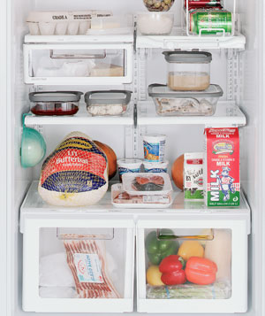
The Refrigerator
“Sell-By (or Pull)” dates on refrigerated foods like milk and chicken tell stores how long to display the product for sale and take into account additional storage time at home. If possible, it’s best to buy a product before this date. Food pantries, soup kitchens and shelters may not always have this option.
“Use-By” dates indicate the last day recommended for use of a perishable product while at peak quality. Some foods that are already past this date, are generally still safe to eat. (use common sense; look, feel, smell, even taste). Simply check the item first for an off odor, a strange appearance, or an unpleasant flavor.

Slide 19
Meat Fish & Poultry
Meat, fish, and poultry: Store meat, fish, and poultry in the coldest part of the refrigerator (generally in the “meat keeper” drawer or toward the back of the bottom shelf), wrapped in foil, leak-proof plastic bags, or airtight containers. Fresh poultry, seafood, and ground or chopped meat can be refrigerated for one to two days before cooking. Fresh red meat, cooked poultry, and meat leftovers can be refrigerated for three to five days, and processed meat products (lunch meats) for three to seven days. Freeze any meat if you won’t be using it within these time frames.

Slide 20
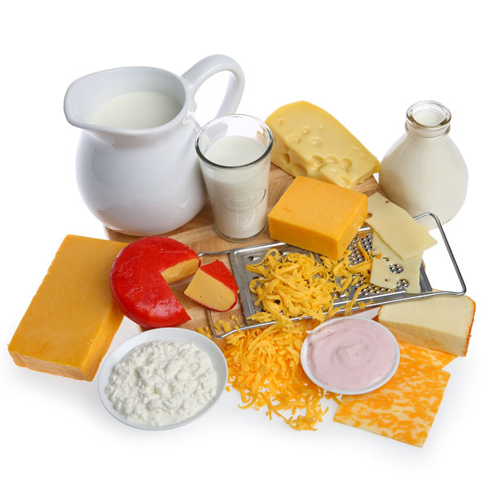
Dairy Products
Dairy products: Milk, cheese, yogurt, and butter tend to spoil more quickly once their dates have passed. However, if stored properly can last up to 6-9 months depending on the product Like eggs, these products should be stored on a shelf, not in the door.

Slide 21
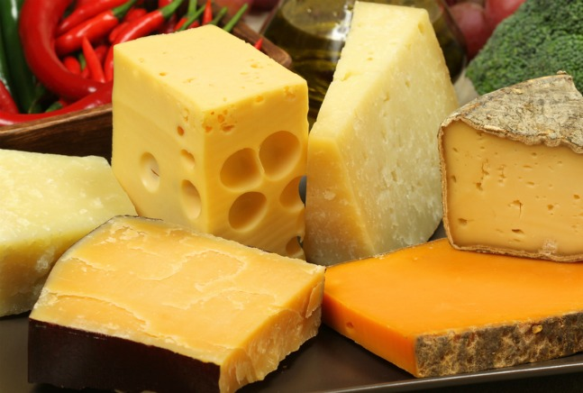
Hard Cheese
How Long Does Hard Cheese Last?
So how long does hard cheese last? When properly stored at or below 40° F, the shelf life of cheese is approximately….
(Unopened) | Fridge | Freezer
 | Past Printed Date | Past Printed Date
Hard Cheese (Parmesan, Asiago, Romano) lasts for | 2-4 Months | 6-8 Months
Shredded Hard Cheese lasts for | 1-2 Month | 6-8 Months
Semi-Hard Cheese Chunk (Cheddar, Swiss) lasts for | 1-2 Months | 6-8 Months
Sliced Semi-Hard Cheese lasts for | 1 Month | 6-8 Months
(Opened) | Refrigerator | Freezer
Hard Cheese Chunk (Parmesan, Asiago, Romano) lasts for | 3-6 Weeks | 6-8 Months
Shredded Hard Cheese lasts for | 3-4 Weeks | 6-8 Months
Semi-Hard Cheese Chunk lasts for | 3-6 Weeks | 6-8 Months
Sliced Semi-Hard Cheese lasts for | 2 Weeks | 6-8 Months

Slide 22
Eggs
Eggs: If you’ve purchased a carton of eggs before the date expires, you should be able to use them safely for three to five weeks after expiration. Eggs should be stored in their original carton on a shelf, not in the door (where it’s not as cold).

Slide 23
EGGs
How Long Do Eggs Last?
When properly stored at or below 40° F, the shelf life of cheese is approximately….
(Shells On) | Past Boiled Date
Hard Boiled Eggs last for | 7 Days
(Peeled) | Past Boiled Date
Hard Boiled Eggs last for | 5 Days

Slide 24
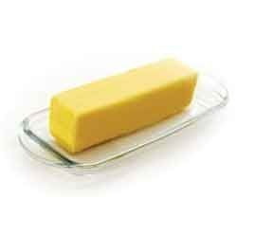
Fat Products
How Long Does Butter Last when it is properly stored at or below 40F
Butter is best before date is approximately….
butter does have some nutritional benefits which include a high dose of vitamin A.
(Unopened) | Refrigerator | Freezer
 | Past Printed Date | Past Printed Date
Butter lasts for | 1 Month | 6-9 Months
Butter with oil lasts for | 2 Months | 6-9 Months
(Opened) | Refrigerator | Freezer
Butter lasts for | 2 Weeks | 6-9 Months
Butter with oil lasts for | 2-3 Weeks | 6-9 Months

Slide 25
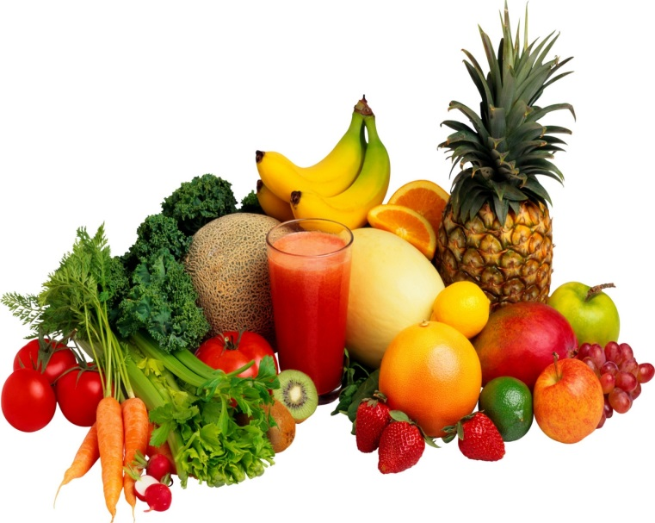
Fruits & Veggies
Fruits and veggies: Raw fruits and vegetables may last anywhere from a couple days to a few weeks before spoiling. (unless green bags or containers are used) For best quality, store ripe fruit in the refrigerator or you can prepare it and then freeze it. Some dense raw vegetables such as potatoes, onions, and tomatoes can be stored in cabinets at cool room temperatures. Other types of raw vegetable should be refrigerated. After cooking, all vegetables must be eaten, refrigerated or frozen within two hours to retain nutrients left.

Slide 26
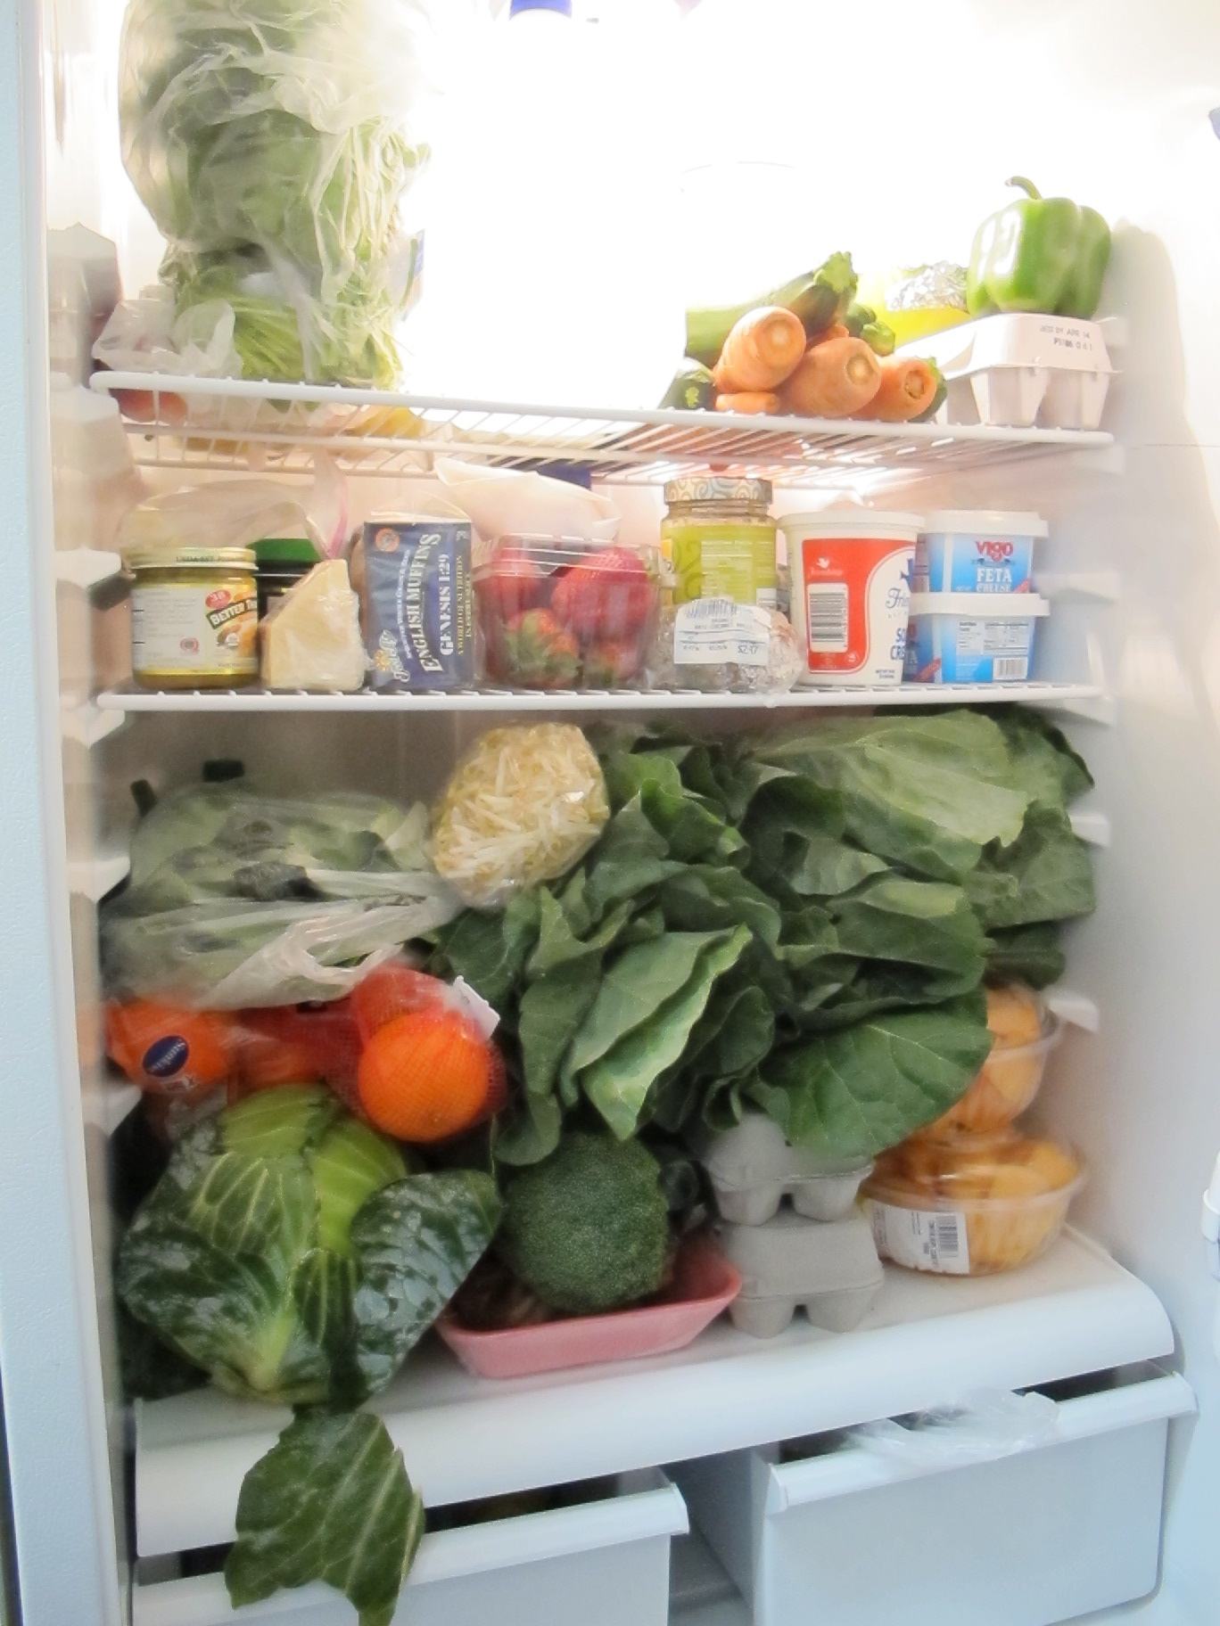
What’s wrong with this fridge?

Slide 27
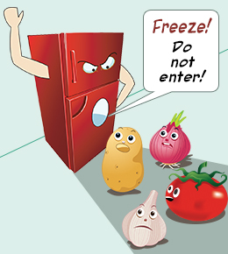
The Freezer
According to the Food and Drug Administration (FDA), frozen foods are safe indefinitely, so their expiration dates apply only to quality and nutritional value. But, make sure the items are frozen solid without signs of thawing. Otherwise:
If you plan to freeze your food, don’t wait to do so. Freezing it right away will help keep the product at its peak quality.
Freeze food in either its original packaging or packed in freezer bags or heavy-duty foil for maximum freshness.
“Freezer-burned” foods are generally still safe to eat. Cut freezer-burned portions away either before or after cooking the food.

Slide 29
Expired Foods Supermarket for Low Income Communities
http://abcnews.go.com/GMA/video/daily-table-grocery-store-sell-expired-food-21634779
Let’s watch………………………

Slide 30
The Bottom Line-”TBL”
Regardless of the date on any product always be on the lookout for spoilage. If a food smells funny to you or has something growing on it that you think shouldn’t be there, throw it out immediately.
Most foods are not only safe to eat, but are also acceptable in terms of taste, aroma, and appearance beyond the expiration date printed on the label. By following these guidelines, you should be able to determine how long foods are good to eat.

Slide 31
R & R…….. Resources & References
Resources & References:
Consumer advice. Food and Drug Administration (FDA) website. Available at: http://vm.cfsan.fda.gov/~lrd/advice.html. Accessed July 10, 2003.
Focus on: food product dating. United States Department of Agriculture (USDA) website. Available at: http://www.fsis.usda.gov/oa/pubs/dating.htm. Accessed July 10, 2003.
Foodborne illness. Centers for Disease Control and Prevention (CDC) website. Available at: http://www.cdc.gov/ncidod/dbmd/diseaseinfo/foodborneinfections_g.htm. Accessed July 10, 2003.
Food storage information. Food Marketing Institute website. Available at: http://www.fmi.org/consumer/foodkeeper/brochure.cfm. Accessed July 10, 2003.
Frequently asked questions about food safety from the USDA Meat and Poultry Hotline. United States Department of Agriculture (USDA) website. Available at: http://www.fsis.usda.gov/oa/faq/hotlinefaqindex.htm. Accessed July 10, 2003.

